Slide 1
Pathshala
AI-Powered Learning & Teaching

Slide 2
1. Problem Statement
Ineffective Search: Standard filters like "Math" or "Physics" are too broad. Students can't find help for specific topics or learning styles.
Accessibility & Cost: Quality, one-on-one tutoring is often expensive (₹300-₹500/hr) and inflexible, making it inaccessible to many.
Impersonal Connection: Tutors and students are matched based on keywords, not on teaching style, learning preferences, or goals, leading to poor fits.

Slide 3
2. Proposed Solution
AI-Powered Smart-Matching: A GenAI engine that understands natural language. A student asks for "help with momentum for an exam," and is matched with a tutor verified in that *exact* topic.
Radical Affordability: A new model making verified tutors available for as low as **₹30 per hour**, democratizing private education.
Intelligent Onboarding: AI-driven conversational profiling and document verification (OCR) to build rich profiles and automate trust.
GenAI Learning Tools: An integrated "Gemini Notes" feature, 24/7 AI Helper bot, and auto-generated quizzes to support learning.`

Slide 4






3. Technology Stack
Frontend
Generative AI
Matching Engine
HTML5, CSS3, and JavaScript for a responsive, lightweight user interface. Deployed globally via Netlify.
Google Gemini API for conversational AI, content generation (notes), and sentiment analysis on reviews.
Vector Database (e.g., Pinecone, Chroma) to store profile "embeddings" and enable high-speed, semantic search for matching.

Slide 5
4. Architecture / Design
4. Smart-Match
2. Embedding
A learner's query ("help with physics") is also converted to a vector. The database finds the closest tutor matches in milliseconds.
User's profile (skills, style) is converted into a numerical "vector embedding" via an AI model.
1. Onboarding
3. Storage
User signs up. GenAI chatbot interviews them, extracts skills, and verifies documents.
This unique vector is stored in a specialized Vector Database, ready for matching.

Slide 6



5. Demo / Screenshots
Homepage
Learning Hub
Gemini Notes
Clean, simple UI prompts the user to select their role: "Learner," "Tutor," or "Both." (Live at jocular-dragon-71ea09.netlify.app)
A simple search bar where users type their query in natural language, e.g., "I need a tutor for 12th-grade calculus."
A dedicated tab where users can type a prompt (e.g., "explain the Kreb's cycle") and instantly generate clean notes and diagrams.

Slide 7
6. Impact & Use Cases
For Learners: Access to hyper-specific, verified help at an unbeatable price (₹30/hr). 24/7 support from an AI Helper.
For Tutors: A steady stream of students who *perfectly* match their teaching style. AI tools to automate verification and build credibility.
For Both: A safe, anonymous, and collaborative ecosystem with AI-generated quizzes, summaries, and goal tracking.

Slide 8
7. Future Scope
Native Mobile Apps: Building dedicated iOS and Android applications for on-the-go learning and push notifications.
AI-Moderated Group Sessions: Expanding beyond 1-on-1 to allow small group "study hall" sessions with an AI moderator.
Full Gamification: Enhancing the "points" system with streaks, leaderboards, and badges to drive student motivation.
Fine-Tuned Models: Training a custom AI model on data from successful sessions to create an even more powerful, specialized matching engine.

Slide 9



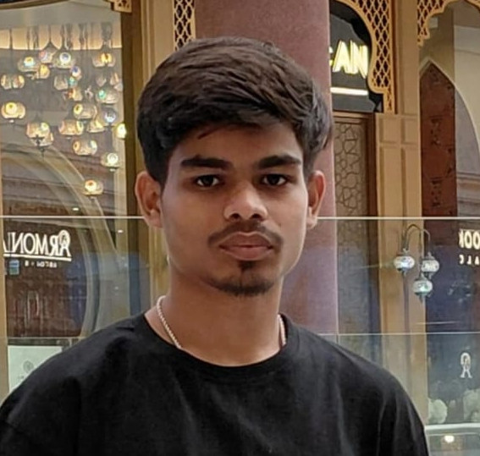


8. Team Members
Adarsh Kumar
Sanny Rai
Ayush Raj
Project Lead /Developer
PowerPoint Presentation
UI Designer

Slide 10
Thank You
Questions?

